Slide 1
Product DFA

Slide 2
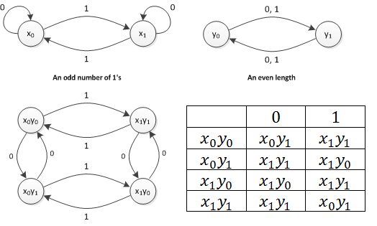
Illustration of Computing Product DFA
 | 0 | 1
->x₀y₀ | x₀y₁ | x₁y₁
x₀y₁ | x₀y₀ | x₁y₀
x₁y₁ | x₁y₀ | x₀y₀
*x₁y₀ | x₁y₁ | x₀y₁
DFA for even length binary strings containing odd number of 1s

Slide 3
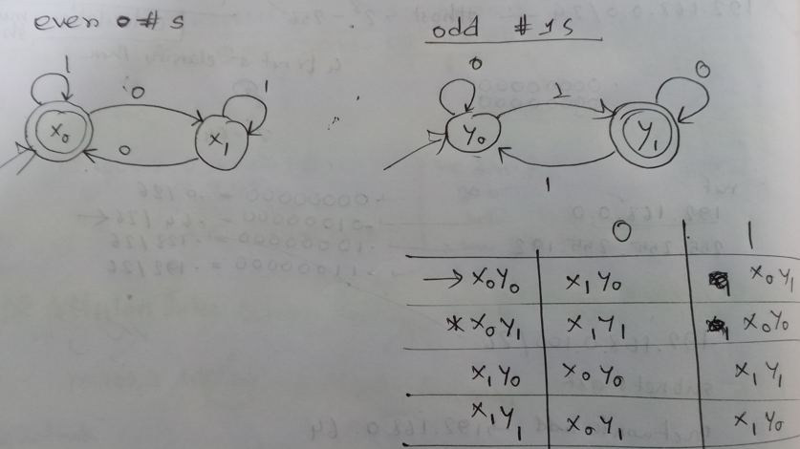
Product DFA for binary strings containing even number of 0s and odd number of 1s

Slide 4
DFA for binary strings that start with 10 and end with 0
Draw transition diagrams of two simpler DFAs first and then use those to compute their product DFA
1,0
1
0
C
1
0
 | 0 | 1
->x₀y₀ | X₃y₁ | X₁y₀
x₀y₁ | X₃y₁ | X₁y₀
x₁y₀ | x₂y₁ | x₃y₀
x₁y₁ | x₂y₁ | x₃y₀
x₂y₀ | x₂y₁ | x₂y₀
*x₂y₁ | x₂y₁ | x₂y₀
x₃y₀ | x₃y₁ | x₃y₀
x₃y₁ | x₃y₁ | x₃y₀
x₀
x₁
x₂
y₀
0
start
1
y₁
0
x₃
1,0
start
1

Slide 5
product DFA of the previous two DFAs (DFA for binary strings which start with 10 and end with 0)
1
x₀y₀
x₀y₁
1
x₁y₀
 | 0 | 1
->x₀y₀ | X₃y₁ | X₁y₀
x₀y₁ | X₃y₁ | X₁y₀
x₁y₀ | x₂y₁ | x₃y₀
x₁y₁ | x₂y₁ | x₃y₀
x₂y₀ | x₂y₁ | x₂y₀
*x₂y₁ | x₂y₁ | x₂y₀
x₃y₀ | x₃y₁ | x₃y₀
x₃y₁ | x₃y₁ | x₃y₀
0
1
0
1
x₃y₁
0
x₃y₀
1
0
0
1
1
x₁y₁
x₂y₀
0
x₂y₁
1
0
0

Slide 6
product DFA (DFA for binary strings which start with 10 and end with 0) after removing useless states (states that are unreachable from the initial state)
1
x₀y₀
x₁y₀
 | 0 | 1
->x₀y₀ | X₃y₁ | X₁y₀
x₁y₀ | x₂y₁ | x₃y₀
x₂y₀ | x₂y₁ | x₂y₀
*x₂y₁ | x₂y₁ | x₂y₀
x₃y₀ | x₃y₁ | x₃y₀
x₃y₁ | x₃y₁ | x₃y₀
0
1
1
x₃y₁
0
x₃y₀
1
0
0
1
x₂y₀
0
x₂y₁
1
0

Slide 7
product DFA (DFA for binary strings which start with 10 and end with 0) after merging equivalent states
1
x₀y₀
x₁y₀
 | 0 | 1
->x₀y₀ | X₃y₁ | X₁y₀
x₁y₀ | x₂y₁ | x₃y₀
x₂y₀ | x₂y₁ | x₂y₀
*x₂y₁ | x₂y₁ | x₂y₀
A | A | A
0
1
A
0
0,1
1
x₂y₀
0
x₂y₁
1
0

Slide 8
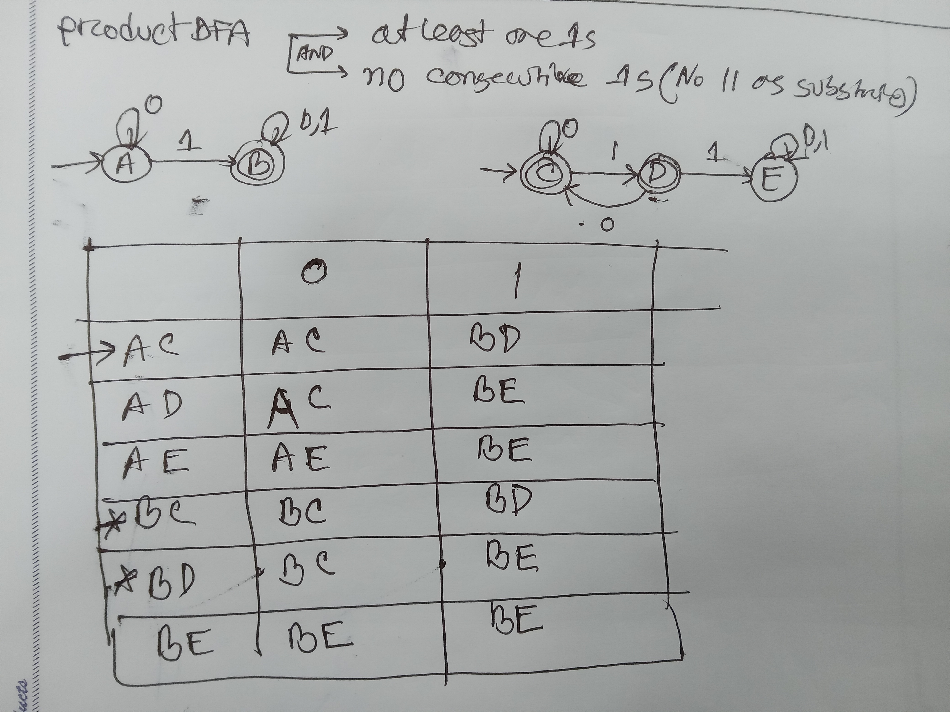
Product DFA for binary strings containing at least one 1s but no consecutive 1s
This DFA contains useless states, what are they? Please simplify the DFA after removing useless states.

Slide 9
Exercise
Draw transition diagram of a DFA which accepts all binary strings that have odd number of 1s and even number of 0s. Use the concept of product DFA.
Draw transition diagram of a DFA which accepts all binary strings that have odd number of 1s and that end with a 0. Use the concept of product DFA.

